Slide 1


Slide 2

MICROSOFT POWERPOINT

Slide 3
WHAT IS A MICROSOFT POWERPOINT
Microsoft PowerPoint is a powerful slide show presentation program.
Microsoft PowerPoint is a software application that is particularly used to present data and information by using text, diagrams with animation, images, and transitional effects etc in the form of slides.
You will learn more about this in upcoming slides.

Slide 4
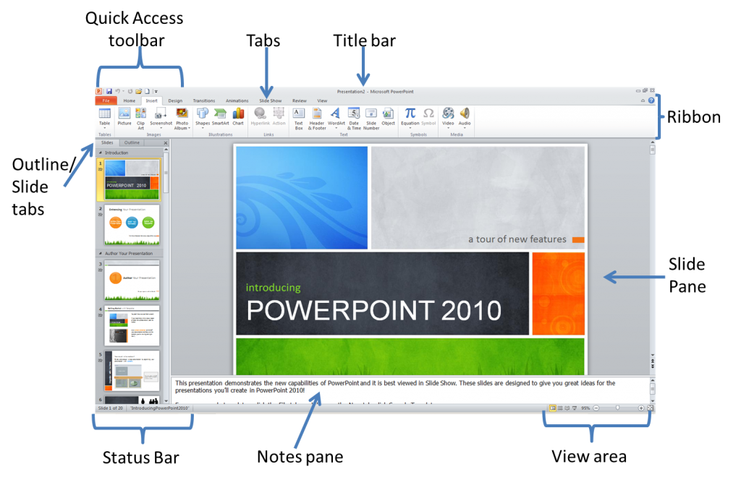

Slide 5
01
Creating PowerPoint Presentation

Slide 6
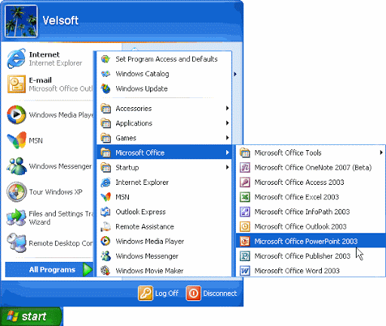
Steps for Powerpoint Presentation:
Microsoft office Powerpoint
Go to start
All Programs
Microsoft office

Slide 7

Steps to Add the slides : Go to home
New slides
Click on slide type You want
Add the slide

Slide 8
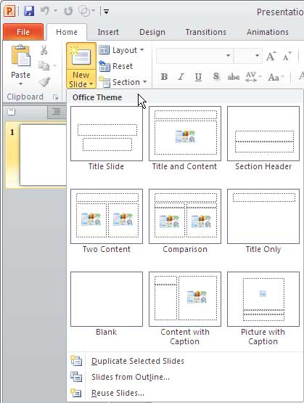


Slide 9

Steps to Delete slide : Click on slide from Slides menu from left side Column
Right click on mouse
Delete the slide

Slide 10
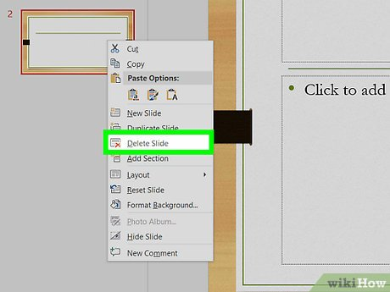


Slide 11
Steps to design page : Go to design
Select Dropdown menu of theme
Added your theme

Slide 12
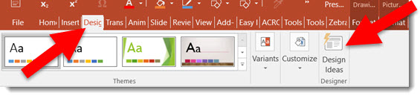

Slide 13

Steps to slideshow: Go to Slideshow
Click on Beginning
Slide show

Slide 14
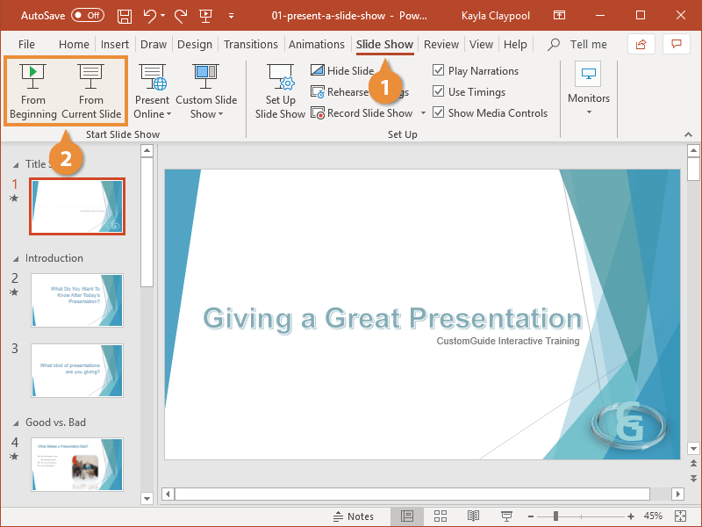

Slide 15

Steps to Save document: Go to File
Save as
Save the name
Select folder to save
Save

Slide 16
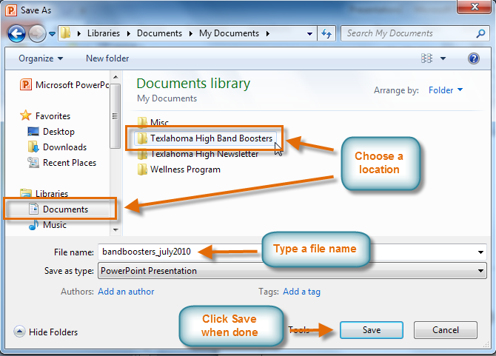
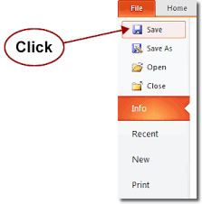

Slide 17
Thank-you

